Slide 1

PANIMALAR ENGINEERING COLLEGE
DEPARTMENT OF COMPUTER SCIENCE ENGINEERING
21CS1512 - SOCIALLY RELEVANT MINI PROJECT
TITLE : RECOMMENDATION SYSTEM FOR ONLINE COURSES
GUIDE BY TEAM MEMBERS :
MR. A. SATHEESH (AP/CS) PREETHIKA M (211422104351)
RAKSHITHA D (211422104379)

Slide 2
ABSTARCT
This paper presents a recommendation system designed to enhance user engagement and learning outcomes in online course platforms. By leveraging collaborative filtering and content-based filtering techniques, the system analyzes user completed course and course content to deliver personalized course suggestions. We conducted an empirical study to evaluate the system's effectiveness, measuring user opting rates and course completion rates. The results demonstrate a significant improvement in user experience and probing efficiency, indicating that tailored recommendations can facilitate better learning paths for diverse learners. Our findings highlight the importance of learning technologies in the evolving and adaptation in to the landscape of today's opportunities in IT field.

Slide 3
ARCHITECTURAL DIAGRAM
Provide a set
of courses
Enroll in the
course
Registration
Login page
Export list of recommended
system
Apply association
rules technique
Import course
enrolments data
Show recommended
course for the learner
Learner takes the
recommended
course

Slide 4
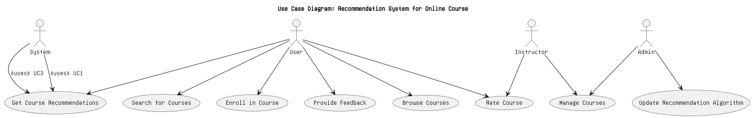
USE CASE DIAGRAM

Slide 5
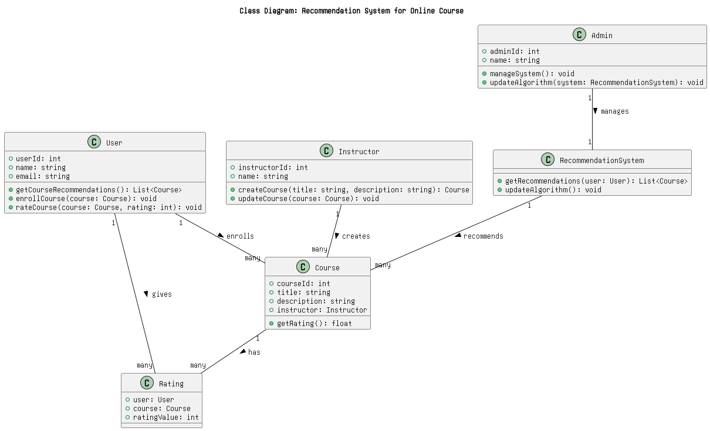
CLASS DIAGRAM

Slide 6
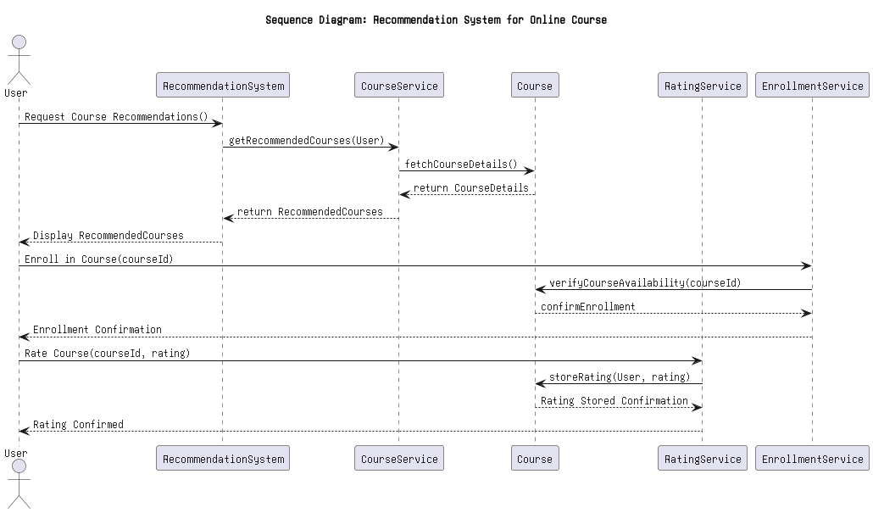
SEQUENCE DIAGRAM

Slide 7
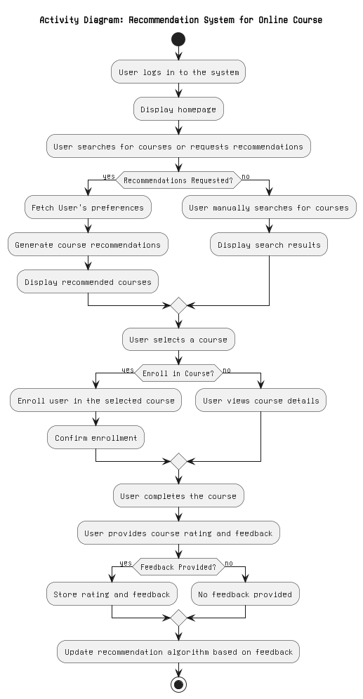
ACTIVITY DIAGRAM

Slide 8
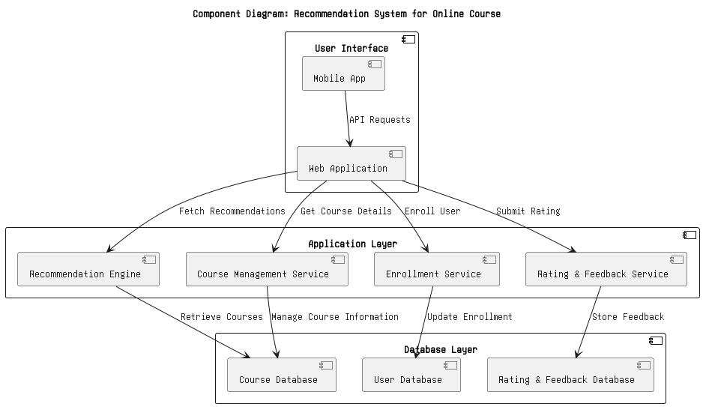
COMPONENT DIAGRAM

Slide 9
Existing system

Slide 10
PROPOSED SYSTEM
The proposed system aims to create an intelligent recommendation engine tailored for online courses, enhancing the user experience by delivering personalized course suggestions. Below are the components and functionalities of the proposed system
Collects information on user interests, learning goals, and preferred course formats Tracks courses completed, time spent on each course, and performance metrics and Evaluates the user’s current skills to recommend appropriate courses for skill development.

Slide 11
Modules
Each module is designed to interact seamlessly, providing a cohesive system that enhances user experience, simplifies course management, and leverages data for personalized learning. The modular architecture allows for scalability and maintainability, making it easier to implement new features or improve existing ones over time.
1. User Management Module
Description: This module handles all aspects of user registration, authentication, and profile management.
2. Course Management Module
Description: This module manages course creation, updates, and organization.
3. Enrollment Module
Description: This module oversees the enrollment process for users into courses.

Slide 12
4. Feedback Module
Description: This module collects and manages user feedback on courses.
5. Recommendation Module
Description: This module generates personalized course recommendations for users.

Slide 13

Screenshot front-end

Slide 14

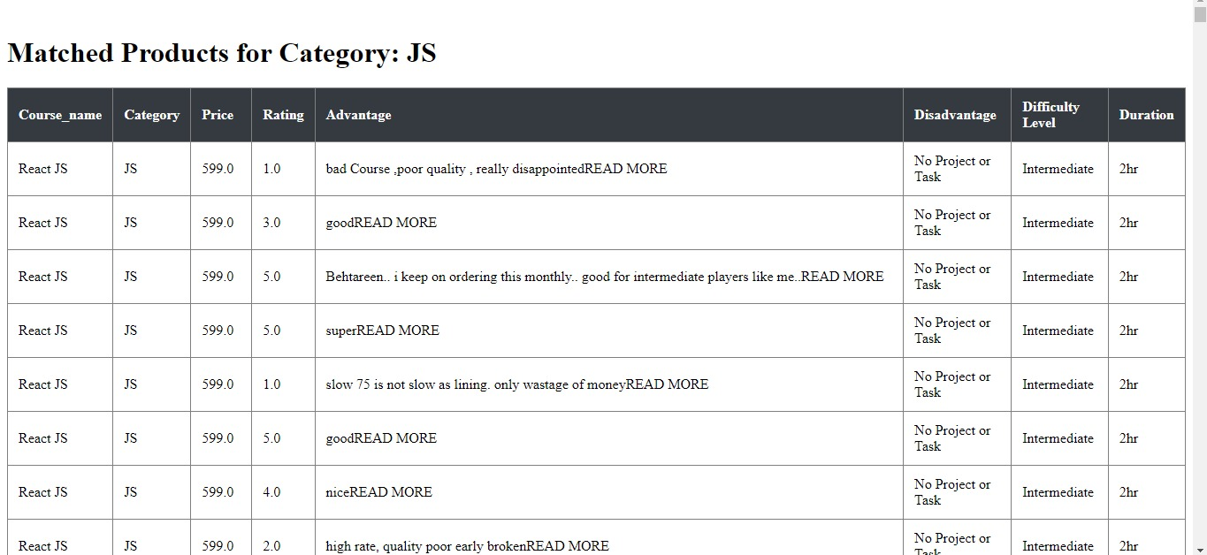
Input output

Slide 15
conclusion
The Online Course Recommendation System is designed to enhance the learning experience by providing personalized course suggestions based on user preferences, behavior, and feedback. This project integrates various components, including user management, course management, recommendation algorithms, and a responsive user interface, to create a cohesive and user-friendly platform. The system prioritizes user experience, enabling seamless registration, course browsing, and enrollment processes. Feedback mechanisms ensure that user opinions are considered for continuous improvement. Utilizing advanced algorithms, the system generates personalized course recommendations, helping users discover relevant content efficiently. This not only increases user engagement but also enhances overall satisfaction with the platform. The architecture supports scalability, allowing the system to handle increased traffic as the user base grows. Performance testing ensures that the system meets acceptable response times, maintaining a high-quality user experience even under load

